Slide 1
Regression Analysis
Poisson Regression
Nicoleta Serban, Ph.D.
Professor
Stewart School of Industrial and Systems Engineering
Introduction

Slide 2

About This Lesson

Slide 3
Other Distributions of the Response
➔ The response variable (e.g. rate) has a Poisson distribution
  What drives the rate of phone calls per day in a calling service center?
  What predicts the density per mile of trees in a forest?
The response variable (e.g. wait time) has an exponential distribution
  What explains the wait time for a wellness visit at your physician offices?
The response variable can have other distributions from the exponential family of distributions
Generalized Linear Model

Slide 4
Standard Linear Regression
Model: Y_{i} = β₀ + β₁x_{i1} + β₂x_{i2}+…+β_{p}x_{ip} + ε_{i}, i =1,…,n
Assumptions:
Linearity/Mean Zero Assumption: E(ε_{i}) = 0
Constant Variance Assumption: Var(ε_{i}) = σ²
Independence Assumption: {ε₁,…, ε_{n}} are independent random variables
Normality Assumption: ε_{i} ~ Normal

Slide 5
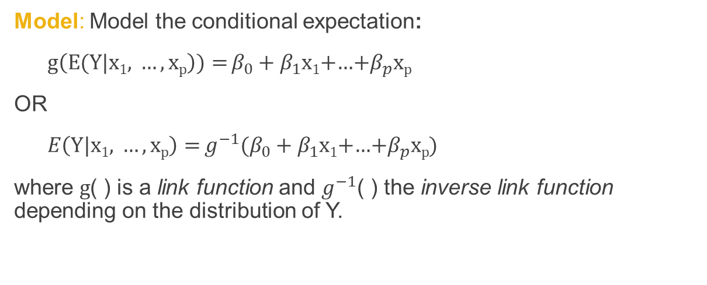
Generalized Linear Model
Data: {(x₁₁,.., x_{1p}),Y₁},….,{(x_{n1},.., x_{np} ),Y_{n}} where Y₁, .., Y_{n} response variable with a distribution from the exponential family
Model: Model the conditional expectation:
${g\left(E(Y|\text{x}\text{1}\text{,} …,\text{x}\text{p}\right)){=}β}_{0}+β_{1}\text{x}\text{1}$+…+$β_{p}\text{x}\text{p}$
OR
${E\left(Y|\text{x}\text{1}\text{, }…,\text{x}\text{p}\right){=}g^{−1}(β}_{0}+β_{1}\text{x}\text{1}$+…+$β_{p}\text{x}\text{p}$)
where $g$( ) is a link function and $g^{−1}$( ) the inverse link function depending on the distribution of Y.

Slide 6
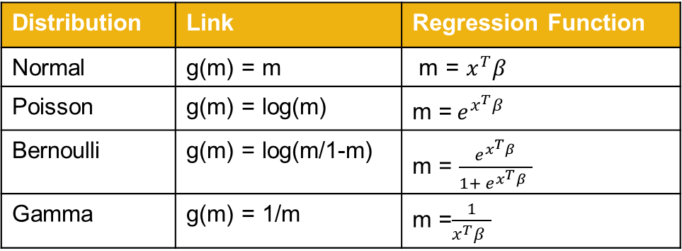
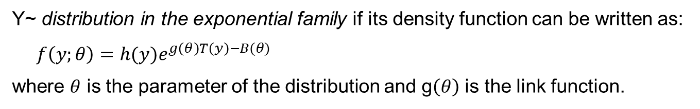
Generalized Linear Model
Y~ distribution in the exponential family if its density function can be written as:
$$f\left(y;θ\right)=h(y)e^{g\left(θ\right)T\left(y\right)−B(θ)}$$
where $θ$ is the parameter of the distribution and g$\left(θ\right)$ is the link function.
Distribution | Link | Regression Function
Normal | g(m) = m | m = $x^{T}β$
Poisson | g(m) = log(m) | m =${ e}^{x^{T}β }$
Bernoulli | g(m) = log(m/1-m) | m = $\frac{{ e}^{x^{T}β }}{1+{ e}^{x^{T}β }}$
Gamma | g(m) = 1/m | m =$\frac{1}{x^{T}β }$

Slide 7

Poisson Regression
Data: {(x₁₁,.., x_{1p}),Y₁},….,{(x_{n1},.., x_{np} ),Y_{n}} where Y₁, .., Y_{n} response variable with a Poisson distribution
Model: Model the conditional expectation:
${log\left(E(Y|\text{x}\text{1}\text{,} …,\text{x}\text{p}\right)){=}β}_{0}+β_{1}\text{x}\text{1}$+…+$β_{p}\text{x}\text{p}$
OR
$$E\left(Y|\text{x}\text{1}\text{, }…,\text{x}\text{p}\right){=} e^{β_{0}+β_{1}\text{x}\text{1}\text{+…+}β_{p}\text{x}\text{p}}$$

Slide 8
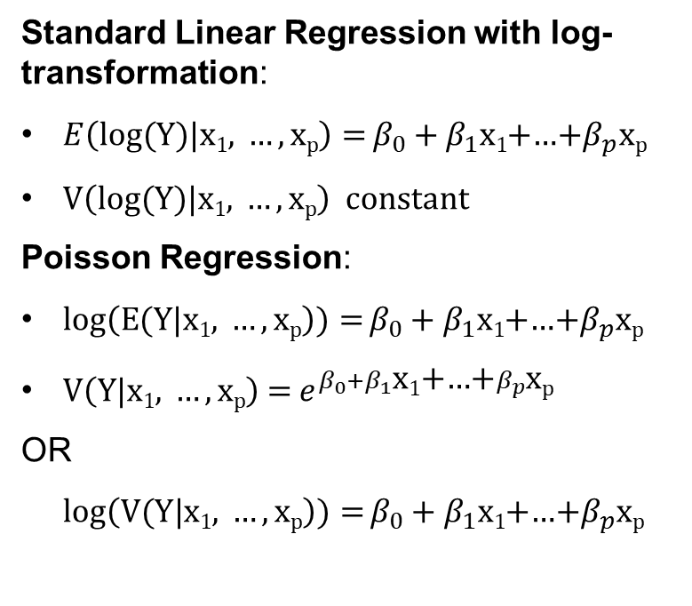
Linear Regression versus Poisson Regression
Standard Linear Regression with log-transformation:
${E\left(log⁡(Y)|\text{x}\text{1}\text{, }…,\text{x}\text{p}\right){=}β}_{0}+β_{1}\text{x}\text{1}$+…+$β_{p}\text{x}\text{p}$
V$\left(log⁡(Y)|\text{x}\text{1}\text{, }…,\text{x}\text{p}\right)$ constant
Poisson Regression:
${log\left(E(Y|\text{x}\text{1}\text{, }…,\text{x}\text{p}\right)){=}β}_{0}+β_{1}\text{x}\text{1}$+…+$β_{p}\text{x}\text{p}$
V$\left(Y|\text{x}\text{1}\text{, }…,\text{x}\text{p}\right)$ = $e^{β_{0}+β_{1}\text{x}\text{1}\text{+…+}β_{p}\text{x}\text{p} }$
OR
${log\left(V(Y|\text{x}\text{1}\text{, }…,\text{x}\text{p}\right)){=}β}_{0}+β_{1}\text{x}\text{1}$+…+$β_{p}\text{x}\text{p}$

Slide 9
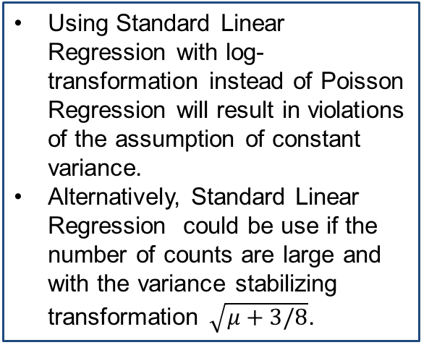
Linear Regression versus Poisson Regression
Standard Linear Regression with log-transformation:
${E\left(log⁡(Y)|\text{x}\text{1}\text{, }…,\text{x}\text{p}\right){=}β}_{0}+β_{1}\text{x}\text{1}$+…+$β_{p}\text{x}\text{p}$
V$\left(log⁡(Y)|\text{x}\text{1}\text{, }…,\text{x}\text{p}\right)$ constant
Poisson Regression:
${log\left(E(Y|\text{x}\text{1}\text{, }…,\text{x}\text{p}\right)){=}β}_{0}+β_{1}\text{x}\text{1}$+…+$β_{p}\text{x}\text{p}$
V$\left(Y|\text{x}\text{1}\text{, }…,\text{x}\text{p}\right)$ = $e^{β_{0}+β_{1}\text{x}\text{1}\text{+…+}β_{p}\text{x}\text{p} }$
OR
${log\left(V(Y|\text{x}\text{1}\text{, }…,\text{x}\text{p}\right)){=}β}_{0}+β_{1}\text{x}\text{1}$+…+$β_{p}\text{x}\text{p}$
Using Standard Linear Regression with log-transformation instead of Poisson Regression will result in violations of the assumption of constant variance.
Alternatively, Standard Linear Regression could be use if the number of counts are large and with the variance stabilizing transformation $\sqrt{μ+3/8}$.

Slide 10

Summary

